Slide 1
New Delta Tau PMAC Driver
Giles Knap
Notes:
Giles Knap
Beamline Controls Engineer at Diamond
Here to talk about the recently completed motion control driver that we are now rolling out to beamlines.

Slide 2
Motion Control at Diamond
Phase 1 beamlines – PMAC – UMAC – External amps
32 axis control. 99% steppers , some servo capability
Used on 12 beamlines
Phase 2 beamlines – GeoBrick-LV-IMS
Integrated 8 axis controller / amplifier. Stepper-servo-step/direction
180 units in service
Phase 3 beamlines – GeoBrick-LV-IMS-II
Redesigned IMS to improve build quality and reliability
DC supply only. No internal transformer
Notes:
The majority of motors at Diamond are driven by Delta Tau controllers.
Our phase 1 (10 years ago) beamlines use
VME crates containing a PMAC card
2 separate axis interface modules (UMAC)
and separate external amplifiers
This required a very crowded full height racks per 32 axes
On Phase two used the more compact Geobrick
A 4U 19” Rack Unit contains everything for 8 axes including
power supplies
Pmac controller
amplifiers
On Phase three we switched to a Geobrick II
3U unit
with simplified electronics

Slide 3
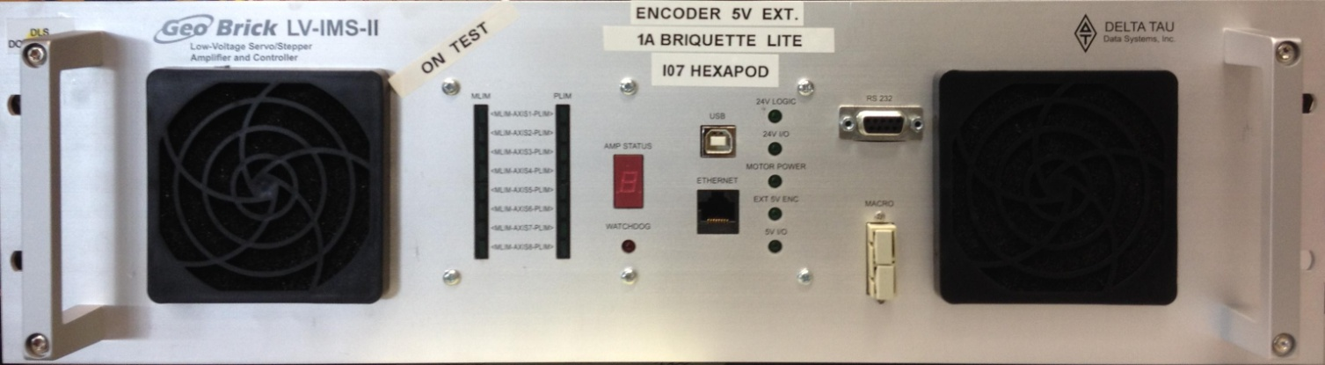
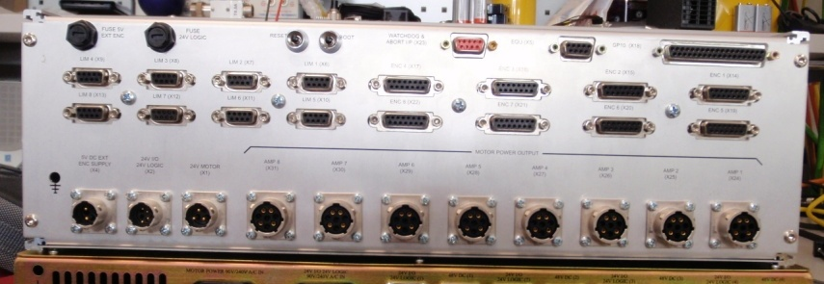
GeoBrick LV IMS II
Limits
Encoders
DC
Input
Motors
Notes:
This is what one of the new Geobrick II units look like
All communications connections and indicators are on the front
All motor connections are on the back
The Mk II does not include power supplies but a single 1U unit can power up to 4 geobricks, so 4 are comfortable in a full height rack.
I have recently configured around 20 of these for the I21 beamline.

Slide 4
Previous Control of PMAC
All PMACs present the same wire protocol (over serial or TCP/IP) so use the same drivers
3 EPICS driver modules were required
tpmac – includes asyn type 2 and 3 control code for raw motors (also type 1 motor interface)
pmacCoord – includes asyn type 2 control code for Coordinate System axes
pmacUtil – provides utility records for PMAC status, auto home, encoder loss, brake control, motion stop, etc.
Multiple points of control, messages sent to PMAC from all of the modules, with each axis having its own event loop
Stream device required for additional messages
Simple and coordinated moves are supported but many features of PMAC are not utilised
Notes:
Tpmac is very old from ANL Argonne National Laboratory.
The others were developed at Diamond.
Coordinate System Axes examples:-
Coordinated control of 6 circle diffractometer using reciprocal space
Provide an Energy axis for a monochromator
Simple:- provide gap and center axes for a pair of slits
The approach of using multiple drivers to provide the full set of services meant that communications to the geobrick could become congested. With complex motion systems such as hexapods we see frequent dropping of messages between the controller and the driver.

Slide 5
Goals of upgrading PMAC modules
Upgrade the driver to Asyn model 3
Combine all control code into a single module
Simplify communications, cut down traffic
Support changing Coordinate Systems on board the PMAC
Support model 3 trajectory scan interface
Maintain backwards compatibility
Notes:
Asyn model 3 motor interface gives the driver developer a set of classes to derive from representing controllers and Axes. Overriding the virtual methods on these classes allows you to implement the protocol appropriate to your controller. This same approach is used for area detector drivers and also the generic AsynPortDriver.
One module is better!
Simpler communications is through the Message Broker described below
The pmacCoord module required that you set up the set of coordinate systems and map axes into them at startup, these were then immutable. We often have requirements for dynamic coordinate systems and the new module supports this
E.g. a 6 circle diffractometer tends to have all of its axes in a CS so that coordinated moves (including in reciprocal space) can be executed such that the device does not crash with itself or the beampipe
However sometimes for powder diffraction you may take one of these axes out and use it to rock the sample
This requires dynamic assignment of axes to coordinate systems
See below for traj scan
Pmac supports all original features of tpmac, pmacCoord and pmacUtil and as far as possible all the EPICS db templates are the same. Migration from the old drivers is reasonably painless

Slide 6
EPICS pmac module
https://github.com/dls-controls/pmac
pmac
pmacCoord
pmacUtil
motor
tpmac
powerPMAC
Replacement for tpmac, pmacCoord, pmacUtil
and powerPMAC_ssh
Notes:
The module is available now on github at the address shown.
The pmac module has been implemented as a replacement for the existing tpmac, pmacUtil and pmacCoord modules.
It contains updated type III asyn driver classes for both standard motors and for coordinate system axes.
But it also adds the features discussed in the rest of this talk.
Finally the module also supports the new delta tau PowerPmac which we are just beginning to use at Diamond. The trajectory scan features are not yet implemented for this device

Slide 7
Features of pmac module
Message Broker
Coordinate System Support
Coordinate System Configuration
Trajectory Scanning
Notes:
The communications method has been updated to improve the efficiency of status requests, by batching groups of status items into a single request message.
The coordinate system axis support from pmacCoord has been included but improved upon (details to follow)
Coordinate systems are now dynamic, axes can be mapped into and out of any number of coordinate systems as required
The most important feature of the module is trajectory scanning which allows us to do continuous scans (fly scans) over arbitrarily complex paths for much faster experiments.

Slide 8
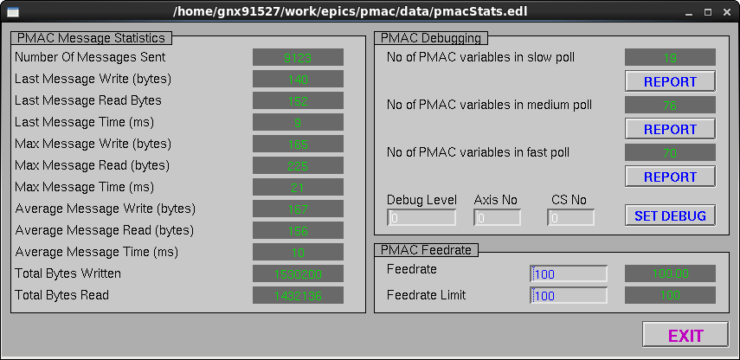
Features: Message Broker
Packages all axes requests into 3 poll loops, slow, medium and fast
Cuts traffic and allows for statistics PVs below:
Notes:
Each axis (real or coordinate system) monitors its state by querying variables on the Geobrick. In this driver the axis classes register with the message broker and it packages up all variable requests into 3 polling loops (slow, medium and fast)
Fast loop polled at 1Hz when no motors are moving and 10Hz otherwise
Fast loop rate can be set
Medium loop polled at 1Hz
Slow loop polled at 0.1Hz
Benefits
Variables requests combined into single large messages to cut down message overhead and traffic
Reduces number of threads and provides better control of message sending to the PMAC
Statistics recorded to monitor traffic
Gui
Allows control of debug level for each axis and CS axis
Can report latest values of the variables in the poll sets

Slide 9
Features: Coordinate Systems
Asyn model 3 CS controller and axis classes
Debug output available for individual axes
Currently assigned coordinate systems available for each motor (Asyn parameters)
Kinematics available (Asyn parameters)
Coordinate systems assignments can be specified during IOC runtime
Communication to PMAC through the broker
Notes:
Hence you can
drive a coordinate system motor through a standard motor record. (In exactly the same way you do for a real axis – connect the motor record through the ASYN Port – with ASYN channel indicating the axis number)
The kinematics are the calculations which are used to convert real to CS axes and vice versa. Previously these were configured on the Geobrick only, the new driver exposes these.
Monitor which axes are in which Coordinate systems
Map axes in and out of coordinate systems. TODO: example
This is important because trajectory scanning is always done within a CS so you need a 1-1 mapping of real to CS motors if you wish to scan real motor positions

Slide 10
Features: Trajectory Scan
Implements continuous (or fly) scans for faster experiments
The original motor record trajectory scan interface is supported with additional records for user modes
(e.g. already implemented for Newport controllers)
Positions and delta times are supplied, velocities are calculated
Scans are executed using PVT mode on the PMAC
The driver reads back the current scan status
Notes:
Mark Rivers originally defined a trajectory scan interface and it is already implemented on Newport controllers
The trajectory is defined in terms of an array positions and times for every motor in the axis
Velocity is calculated
This generates a Position Velocity Time array which is natively supported on the PMAC
The driver monitors progress and allows for abort

Slide 11
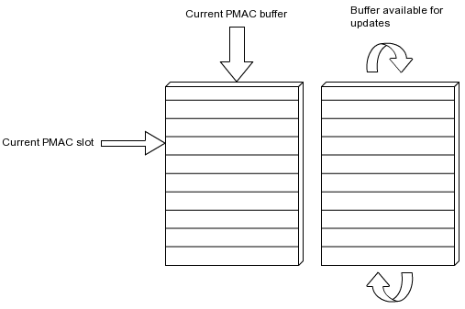
Features: Trajectory Scan
PMAC holds double buffers for continuous points upload
As PMAC hardware reads from buffer A, buffer B is free to be filled by the pmac driver
When PMAC hardware reaches the end of buffer A, it switches to buffer B and A becomes free to be filled by the pmac driver
Notes:
The double buffer system allows for an indefinitely large sequence of positions to be commanded despite limitations of the Geobrick memory.
The user must supply Position and Time data arrays at a fast enough rate that the current buffer is never empty before the other buffer has been filled, otherwise you can continue indefinitely.

Slide 12
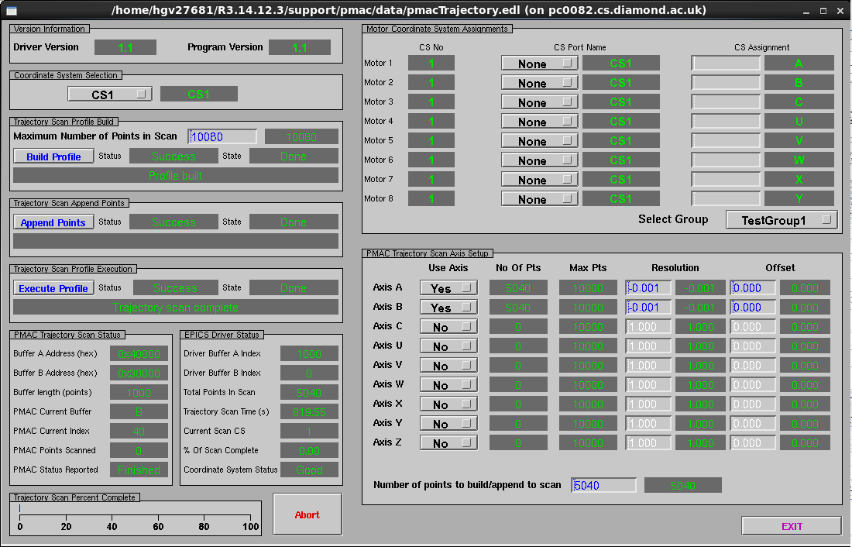
Features: Trajectory Scan
Notes:
This edm GUI gives a view of the PVs and thus the programmatic interface to trajectory scan
Coordinate system section determines which CS we run the scan in
Motor Coordinate System assignments allows us to control the mapping between real axes and CS axes.
Pmac Trajectory Scan Axis Setup configures which of the CS axes are involved in the trajectory and shows if Position and Time Arrays have been uploaded
In this case 5040 positions are uploaded for axes A, B (The array PVs contents are not shown in the GUI)
Once you have set up the above you can run build which verifies parameters and calculates the velocities
Execute profile starts the scan
If the initial set of points needs to be added to then these can be put to the arrays and the use ‘Append Points’
Use this for very large scans where it takes too long to prepare the full set up front
The bottom left panels monitor the interaction between the driver and the pmac, the status of the scan

Slide 13
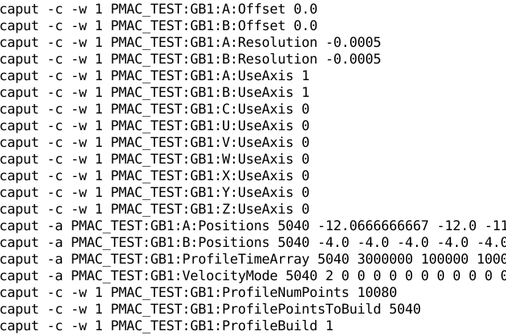
Example Trajectory Scan
Notes:
This is an example of setting up for a snake scan with two axes. As per my description of the previous screen.

Slide 14
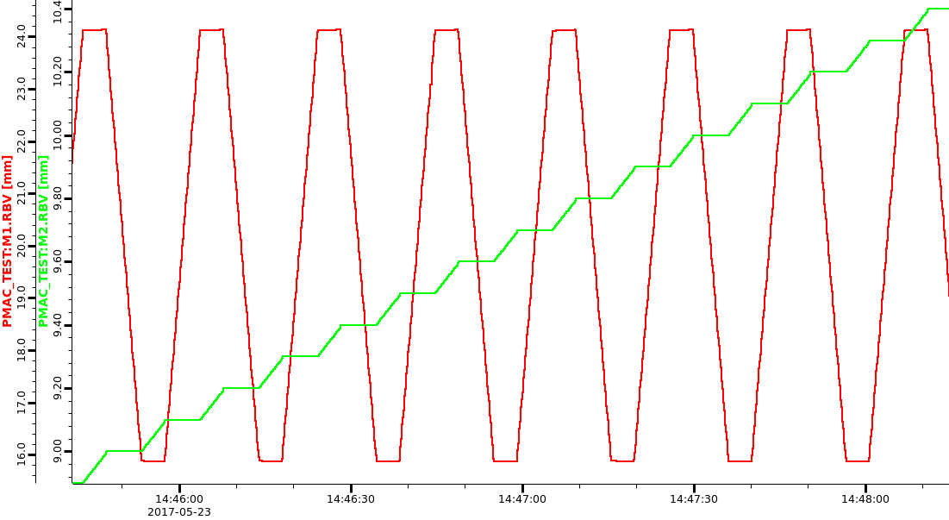
Example Trajectory Scan
Notes:
This is a CSS Databrowser plot of the two axes performing the snake scan.

Slide 15
Thank You
Any Questions?

